Slide 1
Forecast Sun Tracker Device

Slide 2
The purpose of the project
The purpose of the certification work is to develop a prototype of the sun tracking system in the form of a test device for calculating the algorithm for a certain period of time in a certain geographical area.
To achieve this goal it is necessary to solve the following tasks:
consider solar energy as a renewable source and the main methods of its production;
consider the principle of construction of photovoltaic systems and the possibility of automatic tracking of solar panels in the sun;
consider the principle of construction of solar trackers and their types;
choose a technological platform for the implementation of the sun tracking system;
perform system management programming;
perform layout of the developed prototype of the system and conduct a demonstration experiment.
Notes:
Solar energy is one of the branches of alternative (renewable) energy that is really evolving at the speed of light. It is based on the conversion of energy emitted by the Sun into other types of energy, such as electricity or heat. Solar energy is exclusively ecological with no negative impact on the environment. Ukraine is taking important steps to increase the use of RES and alternative fuels as part of its broader strategy to reduce dependence on traditional fossil fuels. It is estimated that our country has the potential to increase the use of renewable energy tenfold by 2030 and reduce natural gas consumption by 15%.It should be noted that the climate and geographical location of Ukraine are favorable for the development of solar energy and the construction of solar or photovoltaic power plants (SES or FES). Even the northern regions of the country have significant potential for the development of this industry, which is not inferior to most European regions.The lack of targets and the small share of energy production are mostly related to the economic component of this area. But recent studies show that about 25% -30% of energy production can be lost simply by not following the position of the sun. Homeowners own the same problem, even more than anyone else.Thus, the urgent task is to prototype a system for tracking the position of the sun and the possibility of testing them with minimal cost. This version of the system is more focused on home power plants.

Slide 3
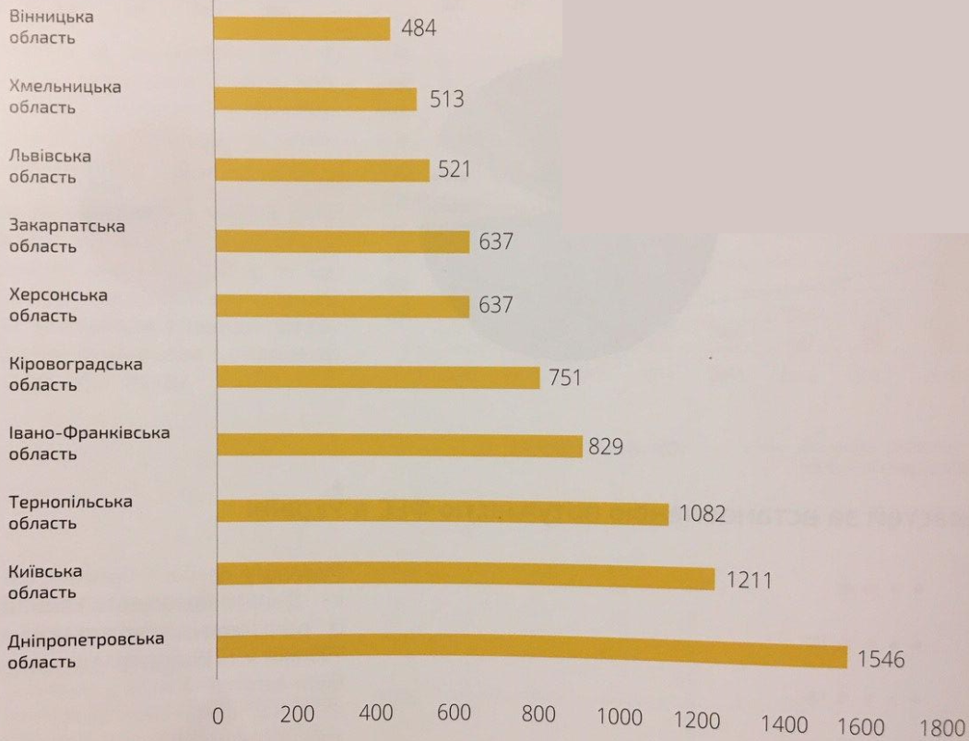
Domestic solar energy in Ukraine
In the first half of 2019, 4438 PVS were installed. This is only 2 units less than in 2018 (4440 PVS) and twice as much as in the whole of 2017 (1901 PVS).
The leader in capacity growth is the Dnipropetrovsk region with record figures.
Top 10 regions by number of PVS of private households
Notes:
The sector of solar power plants in private households has attracted and will continue to attract special attention./ * Read from slide * /This figure shows a comparison of the number of FES throughout the country by administrative region.

Slide 4
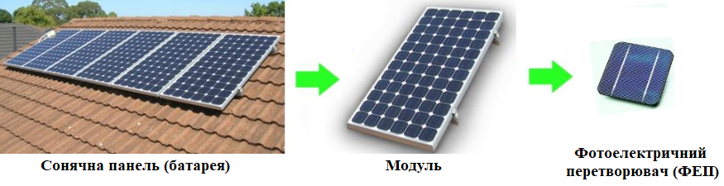
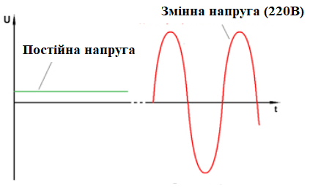
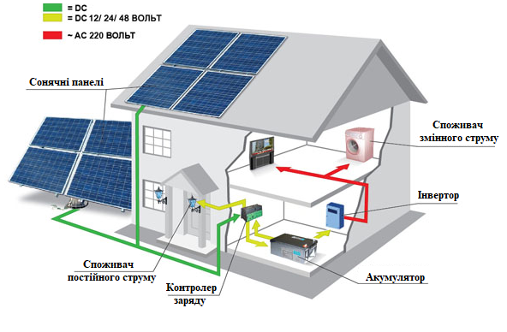
Photovoltaic systems
Components of the solar panel
The essence of voltage conversion
for its consumption in the home
An example of the consumption of extracted electricity using a photovoltaic system
Notes:
Electricity and other types of energy can be obtained directly from the sun, even in cloudy weather. Solar energy is used all over the world and is becoming more and more popular for electricity generation, as well as for heating and desalinating water. Solar energy can be generated by three main ways. Consider the most popular of them and the way examined in certification work and can be modified.
Photovoltaic, photovoltaic (Photovoltaic, PV) or solar elements are semiconductor devices that convert sunlight directly into electrical energy. Modern solar elements are probably an image that learns most people - they are placed on panels installed on the fields, in buildings and in calculators.
Consider the main components of such a system ./* Description of the lowest on the slide drawing * /
The solar panel is a set connected by photomodulus. The photomodulus in turn consists of photocells or photovoltaic converters (PVC).
As a result of the transformation of light energy, the solar panel at its output generates a constant electrical voltage for working in a nominal voltage system systems, as a rule, 12, 24 or 48 volts.
Although internal electronic circuits of many electricity consumers (TVs, computers, household appliances, chargers those many others) work on a constant voltage (and for work have built-in power supplies), yet today, the "ordinary" electric network has a variable Component, and all devices are adapted to power from a network with a variable voltage: 220 volts for a single-phase network, or 380 volts for a three-phase network. Therefore, some solar panels, with constant voltage, for full supply of electricity. The required inverter is an electronic device that converts the DC into the variable.
The solar panel produces electricity when entering its light surface, that is, in the dark, the solar panel "resting". But, as a rule, we need electricity to a day, so a block of battery packs is installed in the system of solar panels. In its appointment, it performs the same function as the battery in a car or in a mobile phone, accumulates electricity at the time of its excess, and gives it at the time of its shortage.
The battery life of the solar panel requires compliance with a certain algorithm. To control the process of charging the batteries, an electronic device is used - a charge controller.
The maximum efficiency of solar panels have a "fall" of sun rays perpendicular to the surface of the module. Since the sun all the time "moves" in the sky, for efficient use of the panel, the use of devices for tracking and turning panel to the sun.

Slide 5
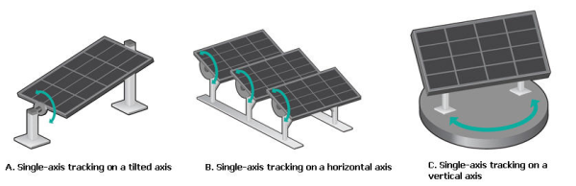
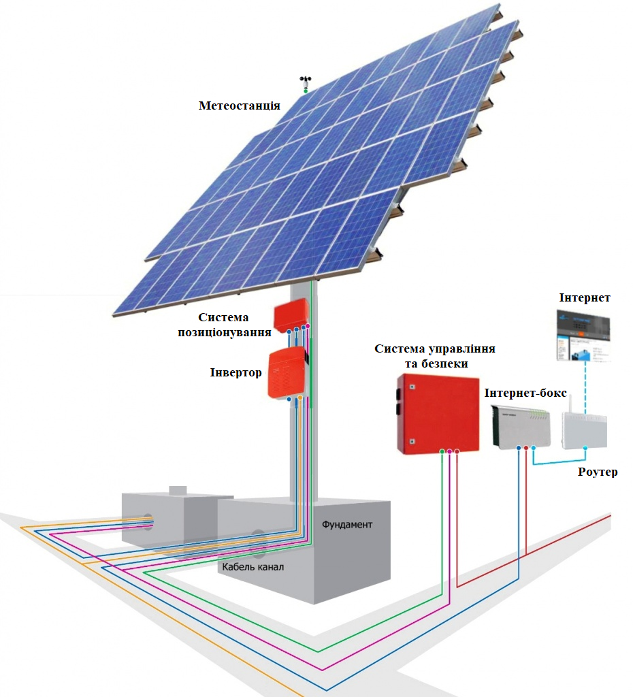
Solar tracker
Types of one-axle trackers
Solar tracker (Solar Tracker) - a device designed to track the position of the Sun and orientation of the carrier design in such a way as to obtain the maximum efficiency (efficiency) of the solar panel, the tracker concept is reduced to several controller sensors that determines the optimal position for the solar battery and forces Servomotors or other engines installed in a moving design, rotate the platform with the panel to the required side.
Full construction of the Sun Tracking system and the example of a two-axle sunshine
5
Notes:
The exact orientation of the working surfaces of the systems into the sun is necessary to achieve their maximum performance. In this case, the tracker's task is to reduce the angle of falling on the work surface of solar panels.
Despite the mass possible differences between trackers, most often they are divided into two types - single-coordinate and two-coordinate. One-coordinate (single-axle) trackers are the most simple and common solar trackers. The tracker that monitors two coordinates is called a two-axle.
The popularity of single trackers is large, but significant electricity losses with large-scale generation lead to large losses. Therefore, it is advisable to use two-coordinate tracking systems.
The moving part of the track can change its position by manual drive, or with the help of 1-2 actuators - executive devices executed on electric motors.
Task tracker - to set the angles of inclination of the working surface of the load by orienting it strictly in the sun. Simply put, sun rays should fall perpendicular to the plane of the solar battery.
This orientation can be achieved in a manner in detail in the next slide.

Slide 6
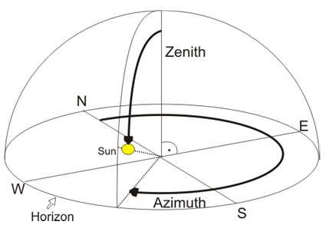
Solar position algorithm
The most effective manner of managing the actuators under the program, which at certain intervals counts the location of the Sun. By internal clock of the device, the program on the control unit will issue information about the value of azimuth and zenith angles, taking into account the tracker location (latitude, longitude, height above sea level), after which the executive device is carried out by the relevant reorientation of the tracker in the estimated position . This method of calculating the location of the Sun is called SPA - Solar Position Algorithm (solar algorithm)
Tracking the sun with
geographic components
Is there data enough?
Notes:
Tracker control devices can be executed on protected computers. PLC - Programable Logic Controller (programmable logic controllers) or in the form of separate devices programmed by the provider when you deliver a tracker, with an attachment to the terrain. The tracker group can be controlled by one computer, which reduces the cost of the power plant.

Slide 7
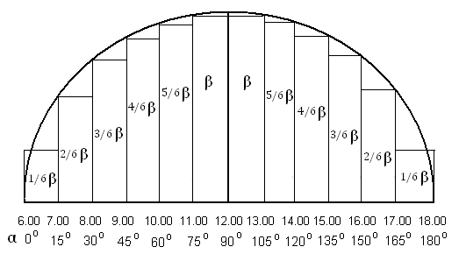
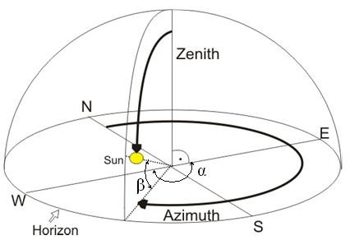

Math modification of the algorithm
An in relation to time and azimuth
β – zenith angle (the height of the sun above the horizon) {0º – 90º};
α – azimutal angle (time angle of movement of the sun in relation to the east) {0º – 180º};
φ – latitude of the observer location (for Kharkiv φ=50^{о});
δ – inclination of the ecliptic due to the inclination of the earth's axis:
  21.03 – day of spring equinox (δ = 0);
  23.09 – day of autumn equinox (δ = 0);
  22.06 – day of summer solstice (δ = 23,5^{о});
  22.12 – day of winter solstice (δ = -23,5^{о}).
ε – a daily change in the bowl of sun (for approximate calculations ε ≈ 0,26):
  ε> 0, if the date in the range of 21 03 to 23.09 inclusive;
  ε <0, if the date ranges from 24 09 to 20.03 inclusive.
  n – number of days to the nearest equinox point:
  If the calculation date is more than 22.06, n is calculated relative to 23.09;
  If the calculation date is less than 22.06, n is calculated relative to 21.03.
Tracking of the Sun Movement by Geographical Components with Added Factors
Formula for calculating a zenith angle at noon:
Notes:
After complementing the figure of the previous slide, we obtain a complete detail of the calculation of azimuthal and anti-aircraft angles. As an example, for approximate calculations, we will consider azimutal turns of solar panels in the period from 6 to 18 hours of explained time, that is, 12 hours of uniform motion of the sun over the horizon. The azimutal angle α is calculated relative to the East of the Heavenly Sphere.
Taking into account that in the period from 21.03 to 23.09, the sun goes to 6.00 and arrives after 18.00, it is assumed that at the beginning and at the end of the settlement semicircular, the anti-aircraft angle is taken 1/6 β.
As an example of calculation we will calculate the anti-aircraft and azimuthal angles of the sun on September 3 at 15 o'clock in Kharkiv.
Given the summer time 15 hour of maternity corresponds to 14 o'clock of the waist time, that is, the azimuthal angle is made up 120^{о}.
The date of September 3 is more than 22.06, so the calculation is relative to 23.09, ie n = 20. September 3 is in the range from 21.03 to 23.09, therefore.
According to the formula β = (90-50) + 20*0,26 = 40+5,2=45,2^{о}.
Zenith angle is 2/3 β, That is 30,13^{о}.

Slide 8
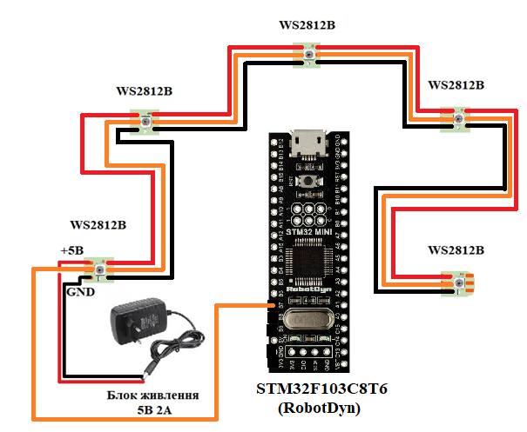
Techno modification of the algorithm
The algorithm of the system
LEDs are connected to the control device, which in a certain period of time reflect the position of the sun in color (12 pieces from 7 to 17 hours);
at night the system goes into standby or sleep mode.
the system is started immediately after connecting the manual to the power supply. The power supply can be both a charger from the phone and various types of power at 3.3V-5V.
It should be noted that the system is not fully automatic in the transition to manual mode. Also, such a system is more adapted to testing, so the algorithm for the position of the sun can be reduced to simulating real indicators. That is, the time of changing the position of the sun will be accelerated by the software and hardware capabilities of the control device.
Schematic implementation the sun tracking position system and testing
Notes:
The software and hardware implementation of the system of tracking the position of the sun and testing the algorithm consists of a microcontroller (control device, CD), which is responsible for outputting information about the position of the sun in space and setting the position of the solar panel. Testing of the algorithm (software implementation) is done with the help of LEDs, which are responsible for the correspondence of the position of the sun and the position of the solar panel.
The software implementation of the device consists of an algorithm for calculating the position of the sun in a certain geographical area according to the algorithm and example, which were discussed on the previous slide.

Slide 9
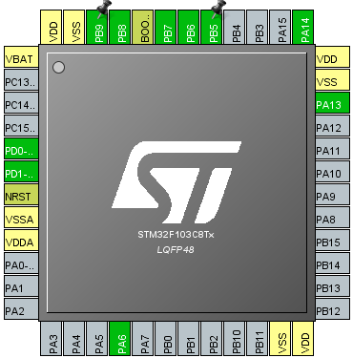
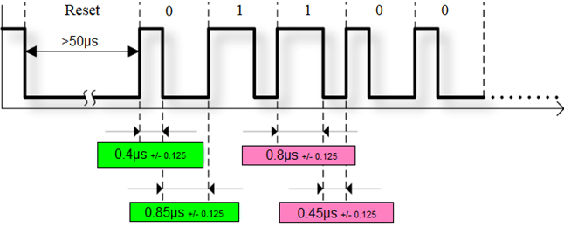
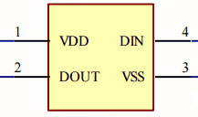
STM32F103C8T6 MCU and WS2812B LED strip
Time characteristics for the implementation of the data transmission protocol (NRZ encoding)
STM32F103C8Tx pin schematic
Block diagram of the WS2812B LED
9
Notes:
STMicro's STM32F103C8T6 series microcontrollers integrate a Cortex M -M3 32-bit ARM processor with up to 72 MHz, high-speed memory (up to 64 KB FLASH and up to 20 KB SRAM), and a function block for peripherals and I / O lines. All series devices support a standard set of communication interfaces (up to two I2C channels, up to two SPI channels, up to three UART channels, one USB channel and one CAN channel), two 10-bit ADCs, up to six 16-bit general purpose timers and PWM. timer with advanced controls. Microcontrollers are designed to operate in the ambient temperature range from -40 ° C to + 85 ° C at a supply voltage of 2.4 V to 3.6 V. Several modes allow you to create applications with low power consumption.
Areas of application STM32F103: portable equipment, audio-video receivers and digital TVs, PC peripherals, gaming platforms, two-wheeled vehicles with electric drive, home appliances, printers, scanners, alarm systems, video conferencing devices, climate control systems.
Physically, the WS2812B has 3 emitting LEDs (red, blue and green) and PWM drivers that control their brightness. PWM drivers are 8-bit, ie 256 brightness gradations are possible for each of the colors. In order to set the brightness of each of the 3 LEDs, you need to transmit 24 pixels (3 bytes) of information to the pixel. The data transfer protocol uses non-return to zero (NRZ) encoding mode. This is a binary linear code in which ones are represented by one significant condition, usually positive voltage, and zeros are represented by some other significant condition, usually negative voltage, without any other conditions (ie, units and zeros of brightness information are encoded by high and low levels. signal in the line).
The transmission time of one bit is 1.25 microseconds - it's pretty fast. The transmission time of the entire packet for one pixel WS2812B is 30ms. For 1000 pieces - 30 ms (which, for example, allows you to update one line 30x30 pixels with a frequency of 30 times per second).
Each of the pixels WS2812B has 2 power contacts (VDD, VSS), input (DIN) and output (DOUT), which are shown in Fig.4.8. Information (24 bits) is fed to the Din input to display the new color. Color information is transmitted bit by bit (starting with the high bit) sequentially for each of the components of the colors G, R, B.

Slide 10
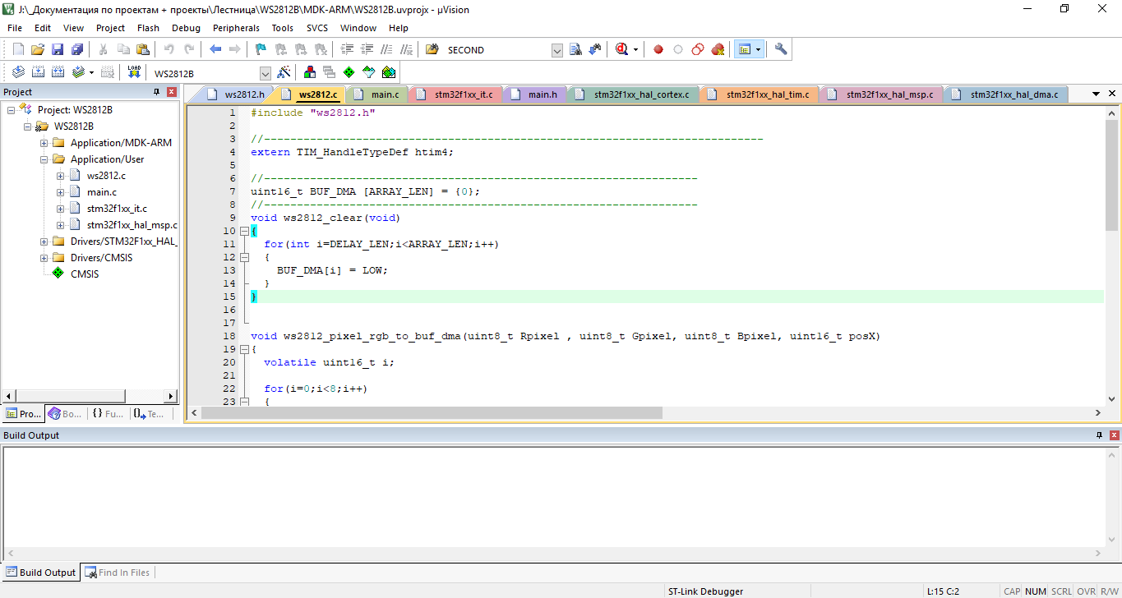

Keil for ARM IDE
The main components of the development environment:
1. Database of microcontrollers, which contains detailed information about all supported devices.
2. Project manager, which serves to combine individual texts of software modules
3. Built-in editor that makes it easier to work with source text through the use of multi-window interface,
4. Tools for automatic compilation, assembly and layout of the project, designed to create a boot module of the program.
Notes:
The Keil development environment is a set of utilities for a complete set of microcontroller software writing activities.
Keil allows you to work with projects of any complexity, from input and correction of source code and ending with in-circuit code debugging and microcontroller programming. Most of the minor features are hidden from the developer, which greatly unloads the interface and makes management intuitive. However, as the complexity of the implemented tasks increases, it is always possible to use the full potential of the modules operating under the control of a single shell.
Read from the slide

Slide 11
Software realization (1)
/* USER CODE BEGIN PV */
typedef enum //enumeration for saving the arrays indexes (time, degrees and beta-coef)
{
SIX, SEVEN, EIGHT, NINE, TEN, ELEVEN, TWELVE, THIRTEEN,
FOURTEEN, FIFTEEN, SIXTEEN, SEVENTEEN, EIGHTEEN
}TIME;
//Need to know the indexes for LED ON/OFF, time and so on
//volatile for ability to change the variable in the interrupt
//
const uint8_t SIZE = 13; //array size
uint8_t time[SIZE] = {6,7,8,9,10,11,12,13,14,15,16,17,18}; //time array
uint8_t degrees[SIZE] = {0,15,30,45,60,75,90,105,120,135,150,165,180}; //degrees array
double beta[SIZE]=
{1/6,2/6,3/6,4/6,5/6,1,1,5/6,4/6,3/6,2/6,1/6};//beta-coefficient size
const uint16_t MARCH = 80; //the 21.03 day of year (not leap)
const uint16_t JUNE = 173; //the 22.06 day of year (not leap)
const uint16_t SEPTEMBER = 265; //the 23.09 day of year (not leap)
volatile uint8_t dayTime = SIX; //variable of day time (from seven to eighteen)
/* USER CODE END PV */
/* Includes ------------------------------------------------------------------*/
#include "main.h"
#include "dma.h"
#include "tim.h"
/* Private includes ----------------------------------------------------------*/
/* USER CODE BEGIN Includes */
#include "ws2812.h"
/* USER CODE END Includes */
/* Private define ------------------------------------------------------------*/
/* USER CODE BEGIN PD */
#define EPSILON 0.26 // approximate value of sun declination daily change
#define LATITUDE 50 // latitude for Kharkiv
/* USER CODE END PD */
11
Notes:
The entire software implementation of the CD is reduced to two tasks. The main task is the essence of the solar tracker. It is necessary to adjust the position of the solar panel relative to the azimuthal and zenith angles (the point of the sun in the sky) at a certain time of day.
For a compact description of the algorithm, the following is a complete list of actions in the software implementation:
Declare all necessary arrays and variables: time array (6 to 18), azimuth angle array (0 to 180), beta coefficient array (1/6 to 1/6), constants of the formula for calculating the zenith angle coefficient (epsilon and latitude) areas)
Definition and initialization of date constants 21.03, 22.06 and 23.09 as ordinal days of the year.
Definition and initialization of the time of day variable.
Initiation of TIM3 operation and permission to interrupt.
Implementation of the basic algorithm in the callback function:
1. calculate maternity time and azimuthal angle behind it;
2. calculate the serial number of the entered date (as an example 03.09). This algorithm is derived into a separate function.
3. calculate the number of days according to the summer solstice (22.06). If the entered date is greater than the corresponding one, the number of days must be calculated on the second date (23.09). Otherwise for 21.03;
6. Determination of the zenith angle according to formula 3.1 and the corresponding coefficient from the array at the current time of day. Increasing the time of day per unit.
The slide shows the software implementation of this algorithm.

Slide 12
Software realization (2)
/* USER CODE BEGIN 4 */
void HAL_TIM_PeriodElapsedCallback(TIM_HandleTypeDef *htim) //Timer interrupt handler(callback)
{
//The variable for counting the result distance between chosen day and the 21.03 or 23.09
//
uint16_t resultDay = 0;
uint8_t maternityTime = time[dayTime]; //variable for understanding current day time
uint8_t azimuth = degrees[dayTime]; //azimuth degree in current day time
if(htim->Instance == TIM3)
{
HAL_TIM_Base_Stop_IT(&htim3); //Stop the timer and forbid the interrupt (for insurance)
//Count the chosen day in the year (03.09)
//
uint16_t chosenDay = CalculateDayInYear(3,9);
if(chosenDay > JUNE) //if the distance between current day and 22.06 (summer solstice) is bigger
{
resultDay = SEPTEMBER-chosenDay; //than we need to calculate relating the last date (23.09)
}
else
{
resultDay = chosenDay - MARCH; //else we need to calculate relating the first date (21.09)
}
//Calculate the zenith angle
//
double zenith = ((90-LATITUDE)+EPSILON*resultDay)*beta[dayTime];
… dayTime = (dayTime+1)%SIZE; //calculate the time from rising to sunset (12 hours)
…}
int main(void)
{…
/* USER CODE BEGIN 2 */
HAL_TIM_Base_Start(&htim3);
HAL_TIM_Base_Start_IT(&htim3);
/* USER CODE END 2 */
…}
The algorithm is implemented, but the function of determining the ordinal number of the day in the year is missing.
12
Notes:
The entire software implementation of the CD is reduced to two tasks. The main task is the essence of the solar tracker. It is necessary to adjust the position of the solar panel relative to the azimuthal and zenith angles (the point of the sun in the sky) at a certain time of day.
For a compact description of the algorithm, the following is a complete list of actions in the software implementation:
Declare all necessary arrays and variables: time array (6 to 18), azimuth angle array (0 to 180), beta coefficient array (1/6 to 1/6), constants of the formula for calculating the zenith angle coefficient (epsilon and latitude) areas)
Definition and initialization of date constants 21.03, 22.06 and 23.09 as ordinal days of the year.
Definition and initialization of the time of day variable.
Initiation of TIM3 operation and permission to interrupt.
Implementation of the basic algorithm in the callback function:
1. calculate maternity time and azimuthal angle behind it;
2. calculate the serial number of the entered date (as an example 03.09). This algorithm is derived into a separate function.
3. calculate the number of days according to the summer solstice (22.06). If the entered date is greater than the corresponding one, the number of days must be calculated on the second date (23.09). Otherwise for 21.03;
6. Determination of the zenith angle according to formula 3.1 and the corresponding coefficient from the array at the current time of day. Increasing the time of day per unit.
The slide shows the software implementation of this algorithm.

Slide 13
Determining the ordinal number
of the day in the year
uint16_t CalculateDayInYear(uint8_t day, uint8_t month)
{
//Simple checking if the data is between 21.03 and 23.09
//e.g. if it is 20.02 then the data is transform to 21.03
//
if(month < 3)
{
if(day < 21)
{
day = 21;
}
month = 3;
}
if(month > 9)
{
if(day > 23)
{
day = 23;
}
month = 9;
}
uint16_t dayOfYear = 0;
dayOfYear = (month + 1)*30.6; //2. 3. 4.
dayOfYear = dayOfYear - 63 + day; //5. 6.
return dayOfYear;
}
/* USER CODE END 4 */
/*
Calculating the day's position in the year from 21.03 to 23.09 (a leap year isn't consider)
1. Enter the month ordinal (from 3 to 9)
2. Add 1 to the month number.
3. Multiply by 30.6.
4. Select the whole part.
5. Subtract 63
6. Add the number corresponding to this day.
As a result, the ordinal number of the day in the year is obtained.
*/
All is done!
13

Slide 14
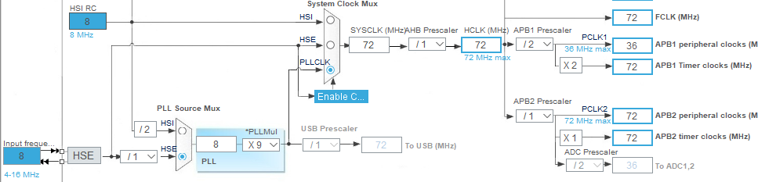
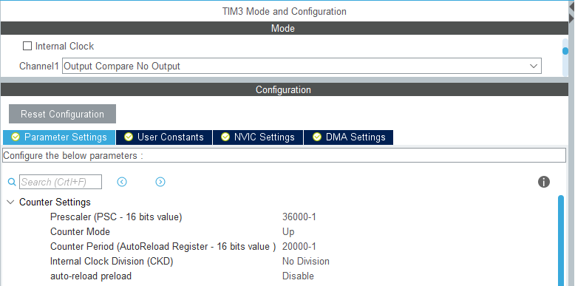
Setting the main peripherals
Settings
Clock Configuration
to connect timers
Timer settings
interrupt TIM3
(to implement the main task and
display tasks
position of the Sun)
14

Slide 15
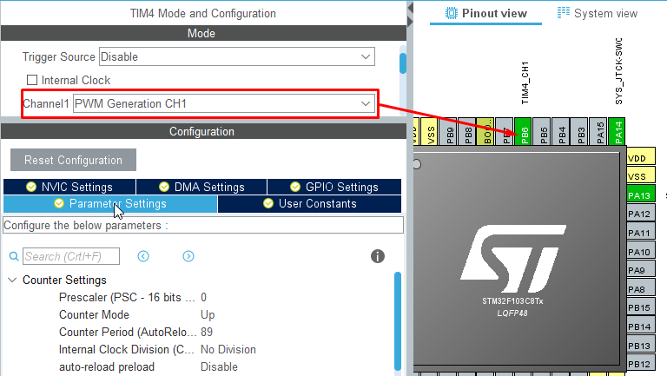
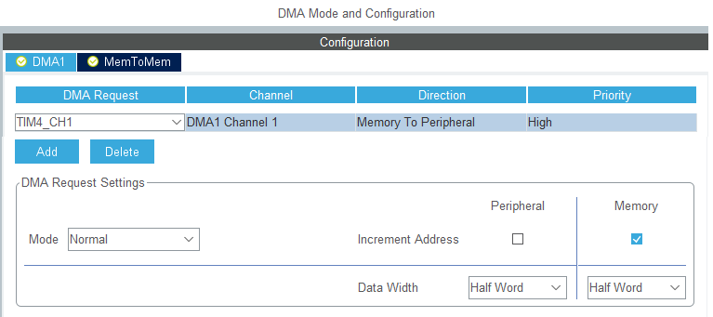
DMA Settings
TIM4 timer connection with PWM channel for DMA
Special DMA channel settings
Notes:
To minimize CPU time, the software implementation uses direct memory access (DMA) technology. This is a technology that allows some hardware subsystems to access the main system memory (random access memory - RAM) independently of the microcontroller processor. This technology is useful at any time when the processor cannot run at an equivalent data rate, or when it is necessary to perform work while waiting for relatively slow I / O (I / O) data transfer.
This is an important configuration for the use of any data transfer (in this paper, data transfer to the LED strip) without a buffer, the role of which is played by the processor.
The advantage of direct access to memory is to minimize the use of microcontroller resources or completely eliminate its participation in data transmission to interact with other microcontroller systems (timers, interrupts, I / O ports, analog-to-digital converter (ADC), etc. .e.).
However, this mechanism still affects the processor. As shown in Figure 5.2, its operation is somewhat slowed down. Because it shares with RDP shared access to RAM and system bus. But measurements have shown that this slowdown in this case does not exceed 0.2%.
To include the technology in the software implementation of the system, it is necessary to implement all the settings and code that are displayed on the slide.
The beginning of color display on LED strips occurs by means of certain step-by-step actions. The first action is a message from the microcontroller about the intersection of infrared sensors in the form of an event or interruption from the external periphery.
An interrupt is a signal that notifies the processor of an event that requires immediate attention. The processor must respond to this signal by interrupting the execution of current instructions and passing control to the interrupt handler (ISR, Interrupt Service Routine). A handler is a common procedure written by a developer whose task is to respond to an event. That is, perform certain operations or instructions for the correct further operation of the system.

Slide 16
Software implementation of
the Sun position
The full implementation of the algorithm also includes an publicly available implementation of the data transmission protocol for LED tapes of the WS2812 / WS2812B type.
//in main.h!
/* Private defines -----------------------------------------------------------*/
/* USER CODE BEGIN Private defines */
#define PERIOD 20000-1 //Set the timer period for 10 seconds (1/2kHz * 20000-1)
/* USER CODE END Private defines */
//in main.c!
/* USER CODE BEGIN PV */
extern uint16_t BUF_DMA [ARRAY_LEN]; //Buffer for DMA transfer data to LED strip
volatile uint8_t LED = 0; //variable of LED ON/OFF each hour
/* USER CODE END PV */
******************************************************************************
* @file stm32f1xx_it.c
* @brief Interrupt Service Routines.
******************************************************************************
/* USER CODE BEGIN Includes */
#include "tim.h" //include the timer library to change their data
/* USER CODE END Includes */
/**
* @brief This function handles DMA1 channel1 global interrupt.
*/
void DMA1_Channel1_IRQHandler(void)
{
/* USER CODE BEGIN DMA1_Channel1_IRQn 0 */
HAL_TIM_PWM_Stop_DMA(&htim4,TIM_CHANNEL_1);
/* USER CODE END DMA1_Channel1_IRQn 0 */
HAL_DMA_IRQHandler(&hdma_tim4_ch1);
/* USER CODE BEGIN DMA1_Channel1_IRQn 1 */
HAL_TIM_Base_Start_IT(&htim3);
/* USER CODE END DMA1_Channel1_IRQn 1 */
}
This implementation consists of two files, which prescribe all the necessary data for working with LEDs, namely: their frequency (number of cycles), the number of LEDs in the tape, the data buffer for transmission and the implementation of their combustion.
Notes:
Similar to the software implementation of the algorithm can describe the data transfer to the LED strip:
Initiation of the buffer array of LED color transmission.
Definition and initialization of the current LED variable.
In the implemented callback function to create a selector for selecting a specific LED and color for the time of day (from east to west).
Interrupt permission from TIM4 (DMA), which fills the buffer.
Data transfer during PDP interrupt processing, its completion and permission for the next interrupt generation from TIM3.

Slide 17
Software implementation of
the Sun position
The full implementation of the algorithm also includes an publicly available implementation of the data transmission protocol for LED tapes of the WS2812 / WS2812B type.
//in main.h!
/* Private defines -----------------------------------------------------------*/
/* USER CODE BEGIN Private defines */
#define PERIOD 20000-1 //Set the timer period for 10 seconds (1/2kHz * 20000-1)
/* USER CODE END Private defines */
//in main.c!
/* USER CODE BEGIN PV */
extern uint16_t BUF_DMA [ARRAY_LEN]; //Buffer for DMA transfer data to LED strip
volatile uint8_t LED = 0; //variable of LED ON/OFF each hour
/* USER CODE END PV */
This implementation consists of two files, which prescribe all the necessary data for working with LEDs, namely: their frequency (number of cycles), the number of LEDs in the tape, the data buffer for transmission and the implementation of their combustion.
******************************************************************************
* @file stm32f1xx_it.c
* @brief Interrupt Service Routines.
******************************************************************************
/* USER CODE BEGIN Includes */
#include "tim.h" //include the timer library to change their data
/* USER CODE END Includes */
/**
* @brief This function handles DMA1 channel1 global interrupt.
*/
void DMA1_Channel1_IRQHandler(void)
{
/* USER CODE BEGIN DMA1_Channel1_IRQn 0 */
HAL_TIM_PWM_Stop_DMA(&htim4,TIM_CHANNEL_1);
/* USER CODE END DMA1_Channel1_IRQn 0 */
HAL_DMA_IRQHandler(&hdma_tim4_ch1);
/* USER CODE BEGIN DMA1_Channel1_IRQn 1 */
HAL_TIM_Base_Start_IT(&htim3);
/* USER CODE END DMA1_Channel1_IRQn 1 */
}
Notes:
Аналогічно програмній реалізації алгоритму можна описати передачу даних до світлодіодної стрічки:
Ініціація буферного масиву передачі кольору світлодіоду.
Визначення та початкова ініціалізація змінної поточного світлодіоду.
В реалізованій функції зворотного виклику створити селектор вибору конкретного світлодіоду та кольору за часом доби (від сходу до заходу).
Дозвіл на переривання від TIM4 (DMA), в якому заповнюється буфер.
Передача даних при обробці переривання ПДП, її завершення та дозвіл на наступне генерування переривання від TIM3.

Slide 18
Software implementation of
the Sun position
/* USER CODE BEGIN 4 */
void HAL_TIM_PeriodElapsedCallback(TIM_HandleTypeDef *htim) //Timer interrupt handler(callback)
{
//Every 10 seconds of interrupt is equal to 1 hour
//
switch(LED)
{
case 0:
ws2812_clear(); //6:00. the gray sky. People can not see smth yet
break;
case 1:
ws2812_pixel_rgb_to_buf_dma(150,0,204,LED); //7:00. the violet symbolizes the rising
break;
case 2:
ws2812_pixel_rgb_to_buf_dma(255,0,0,LED); //8:00. the red sky during the sunrise
break;
...

Slide 19
Software implementation of
the Sun position
…
case 11:
ws2812_pixel_rgb_to_buf_dma(150,0,204,LED); //17:00. purple color means the nearest point to sunset
break;
case 12:
ws2812_clear(); //18:00. The sun is not in the vision and we suppose that is the full sunset
break;
default:
for(uint8_t i = 0; i<LED_COUNT;i++)
{
ws2812_pixel_rgb_to_buf_dma(255,255,255,i); //default case for unpredictable program behaviour. White color
}
break;
}
//While the data is not transfer to LED strip
//waiting for this
//
while(HAL_TIM_PWM_Start_DMA(&htim4,TIM_CHANNEL_1,(uint32_t*)&BUF_DMA,ARRAY_LEN));
LED = (LED+1)%SIZE; //%SIZE(13) gives the LED value from 0 to 12
__HAL_TIM_SET_AUTORELOAD(&htim3, PERIOD); //Reload the timer for interrupt restarting
HAL_TIM_Base_Start_IT(&htim3); //return the interrupt mode
}
}
Notes:
The interrupt handling mechanism was used to implement the main function of the CP and the function of displaying the position of the Sun with the help of LED strips. It is impossible to optimize and sometimes even implement a program for microcontroller-based solutions without the use of interrupts (meaning the use of interrupt handlers and callback functions).
Tasks are implemented in the HAL_TIM_PeriodElapsedCallback function. After data transfer, the processor initiates an interrupt from DMA to data transfer. It is not possible to process such an interrupt as a callback function, because in this case it does not exist. However, the automatically generated interrupt handler DMA1_Channel1_IRQHandler is successfully used to finally complete the transfer of the data buffer to the tape and resume interruption from the main timer TIM3.

Slide 20
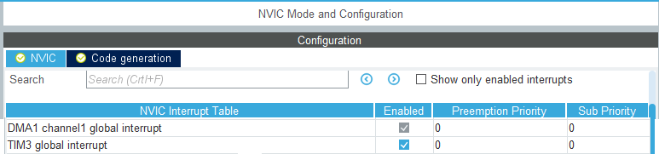
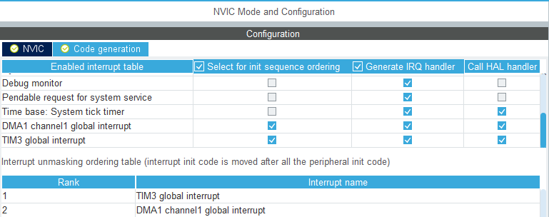
Interrupt mechanism setting
Permission for required interrupts (DMA and TIM3)
The order of generating interrupts in the code.
Optional, but demonstrates
understanding of major and minor interruptions
Notes:
Interrupt - a signal that notifies the processor of the occurrence of an event that requires immediate attention.
The use of an interrupt mechanism in this work is mandatory, as the use of another mechanism (DMA) requires interrupt work.
The whole mechanism of interrupting the CD is very simple. First you need to initiate another timer, from which once in a certain period of time will initiate an interruption of data transmission from the data buffer to the LED strip. Then, after fulfilling the points shown in Fig. 3.6 and Fig. 3.7, it is also necessary to initiate an interruption from TIM4, and more precisely from its first channel, which is associated with the DMA.
There must be two timers in this circuit. Interruption from the timer for work with DMA works only as PWM (pulse-width modulation) at 20 kHz (1.25 μs - operating time of one LED according to the protocol), and another timer (master or initiator) already has a certain period, overflow of which causes interruptions.

Slide 21
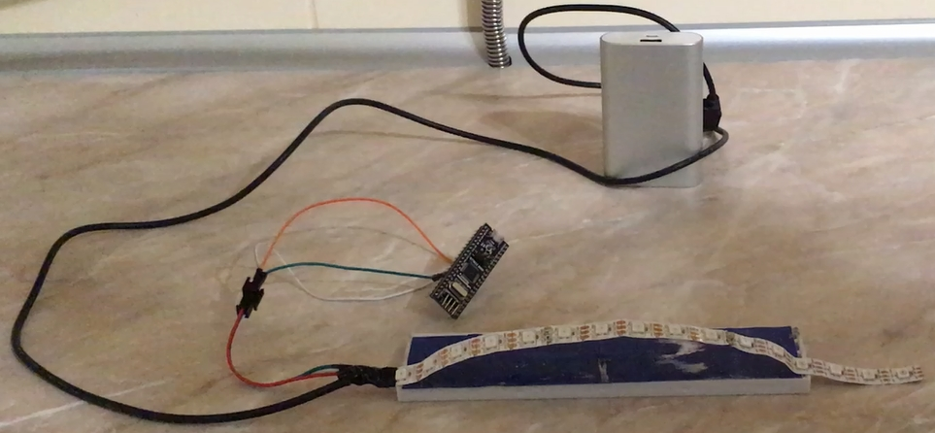
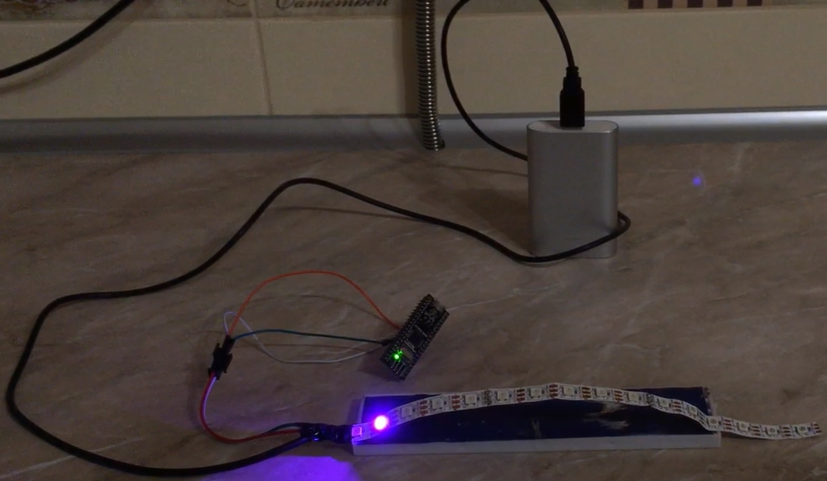
Layout and Demonstration
General view of the layout based on the STM32 RobotDyn debug board
Demonstration 7 o'clock in the morning
Notes:
The demonstration experiment performs a visual function. It reflects the movement of the Sun in the sky from 6 am to 6 pm. The colors of the LEDs are paired and have the following classification “P-R-B-LB-Y-O-Y-LB-B-R-P" (first letters of colors). the full zenith is reflected in orange. All colors are associated with the visual representation of colors in the sky from sunrise to sunset.The layout of the control device includes a STM32F103C8T6 microcontroller, 13 WS2812B LEDs (6 hours to 18 hours inclusive) and a power source: AC-DC adapter for charging a mobile phone or power bank. It has been empirically proven that power bank practically does not distort the information displayed in the form of colors. Because the network is unstable, the voltage drops are negatively reflected in the layout. There is no stabilization, so the nominal and maximum voltage of the model from the network should be 220V-230V.

Slide 22
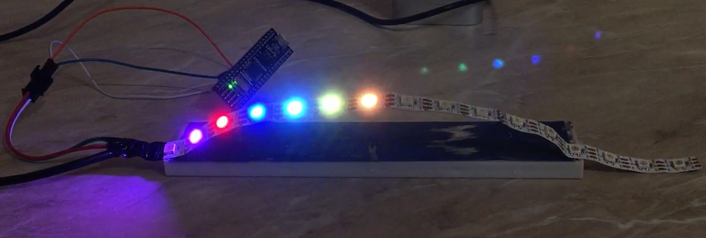
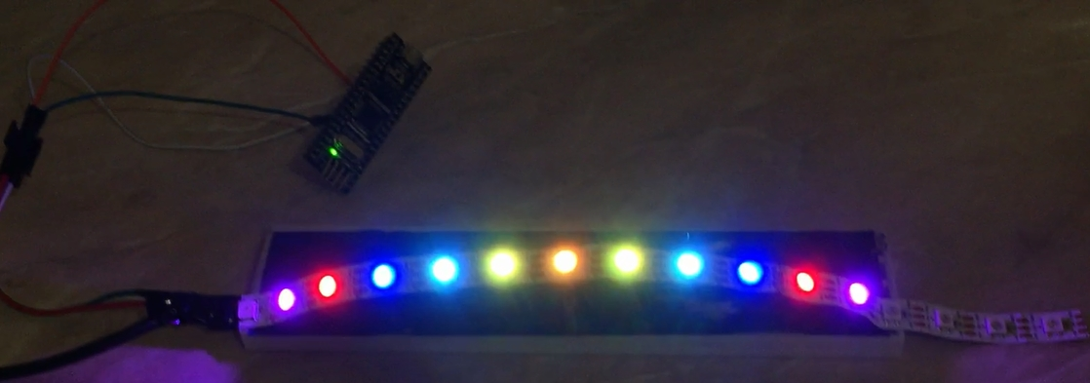
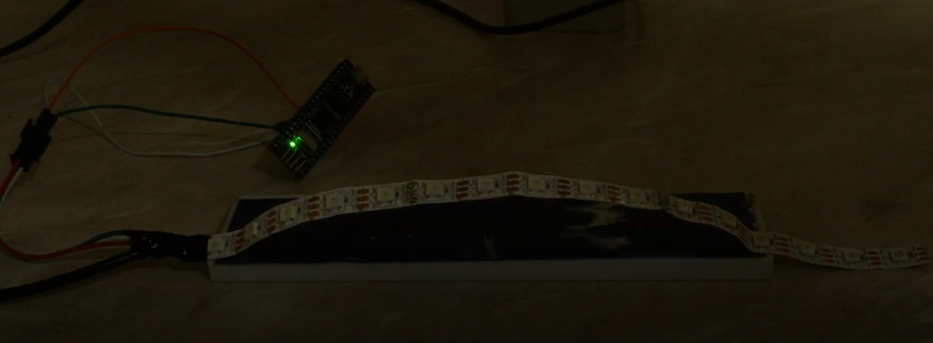
Layout and Demonstration
The peak of the sun
on the celestial sphere (zenith)
Full cycle of the sunrise
and sunset
Night
Notes:
The LED strip physically displays a hemisphere of 13 LEDs. The first and last LEDs do not light, displaying 0 ° and 180 ° azimuthal angle, respectively.
Under the condition 6 o'clock in the morning has an azimuthal angle of 0 °, so the first color (purple) reflects 7 o'clock in the morning. Then each hour - its own LED.
The second half of the hemisphere is filled with colors in the opposite direction.
After the imitation of the sunset (17 o'clock) there is an "imaginary" night with a duration of 20 seconds. The time change can be done programmatically.

Slide 23
Conclusions
A prototype of the sun position tracking and testing system based on the solar positioning algorithm was developed.
The principle of building a solar energy production system based on solar panels and the scale of their use are considered in detail.
Types of PVS with the ability to track the movement of the sun with their disadvantages and advantages are considered.
The control device is implemented on the basis of the microcontroller STM32F103C8. The software implementation of the control algorithm is carried out in the C programming language in the Keil for ARM development environment. This microcontroller is a basic and standard control device for general use. Replacing this manual with a cheaper one is not considered by anyone at all. The use of a more advanced microcontroller only makes sense when the system functions are multiplied, which is also unreasonable.
Modeling of the developed control device was carried out in the form of a layout of the circuit implementation of the system. The efficiency of the prototype system is confirmed. No deviations from the expected result were detected.

